Slide 1




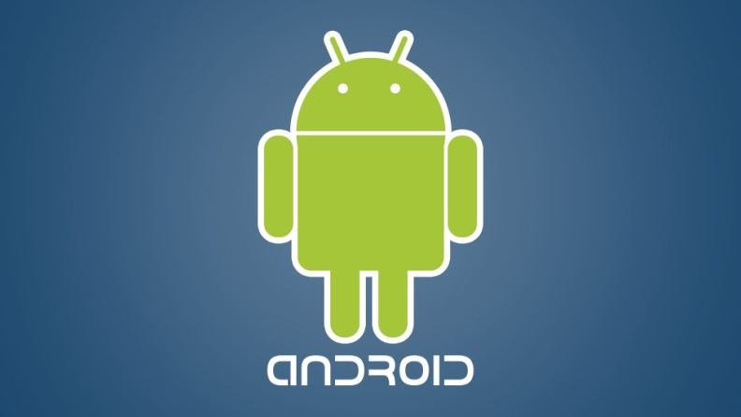
Appium & Selenium Testing Practice

Slide 2

Most common user gestures on Mobile Devices:

Slide 3
Tap: Touch surface briefly: TouchAction ta = new TouchAction(driver); ta.tap(aeExpandList).perform();

Slide 4
Drag and drop: Move along surface without breaking contact. .
TouchAction action = new TouchAction(driver);
action.longPress(ae2).moveTo(ae3).release().perform();

Slide 5
Scroll: Scroll Mobile App page down and Up. .
driver.findElementByAndroidUIAutomator("new UiScrollable(new UiSelector()).scrollIntoView(text(\"TextClock\"));");

